Slide 1

Powershell Basics & TDD
Introduction to PowerShell Basics, Unit Testing and TDD

Slide 2
Program
Session 1
What is Ensemble Programming? What is TDD? How do I write a unit test? How do I work with git? Exercise Kata
Session 2
Exercise Kata (cont).
Session 3
Working with existing code (Bring Your Own Script)
Session 4
Working with existing code (cont.)

Slide 3
Session 1
Agenda
# | Time Required | Activity
1 | 5 min | This introduction to the course
2 | 5 min | Introduction round: who are you? What do you hope to get out of this training?
3 | 10 min | Introduction to Ensemble Programming & Test-Driven Development (TDD)
4 | 90 min | Exercise ‘kata’: Scientific Calculator
5 | 10 min | Retrospective

Slide 4

Introduction Round
What’s your name?
iOS or Android?
Do you have experience with Powershell?
What do you hope to get out of this training?
Who gets to go next?

Slide 5

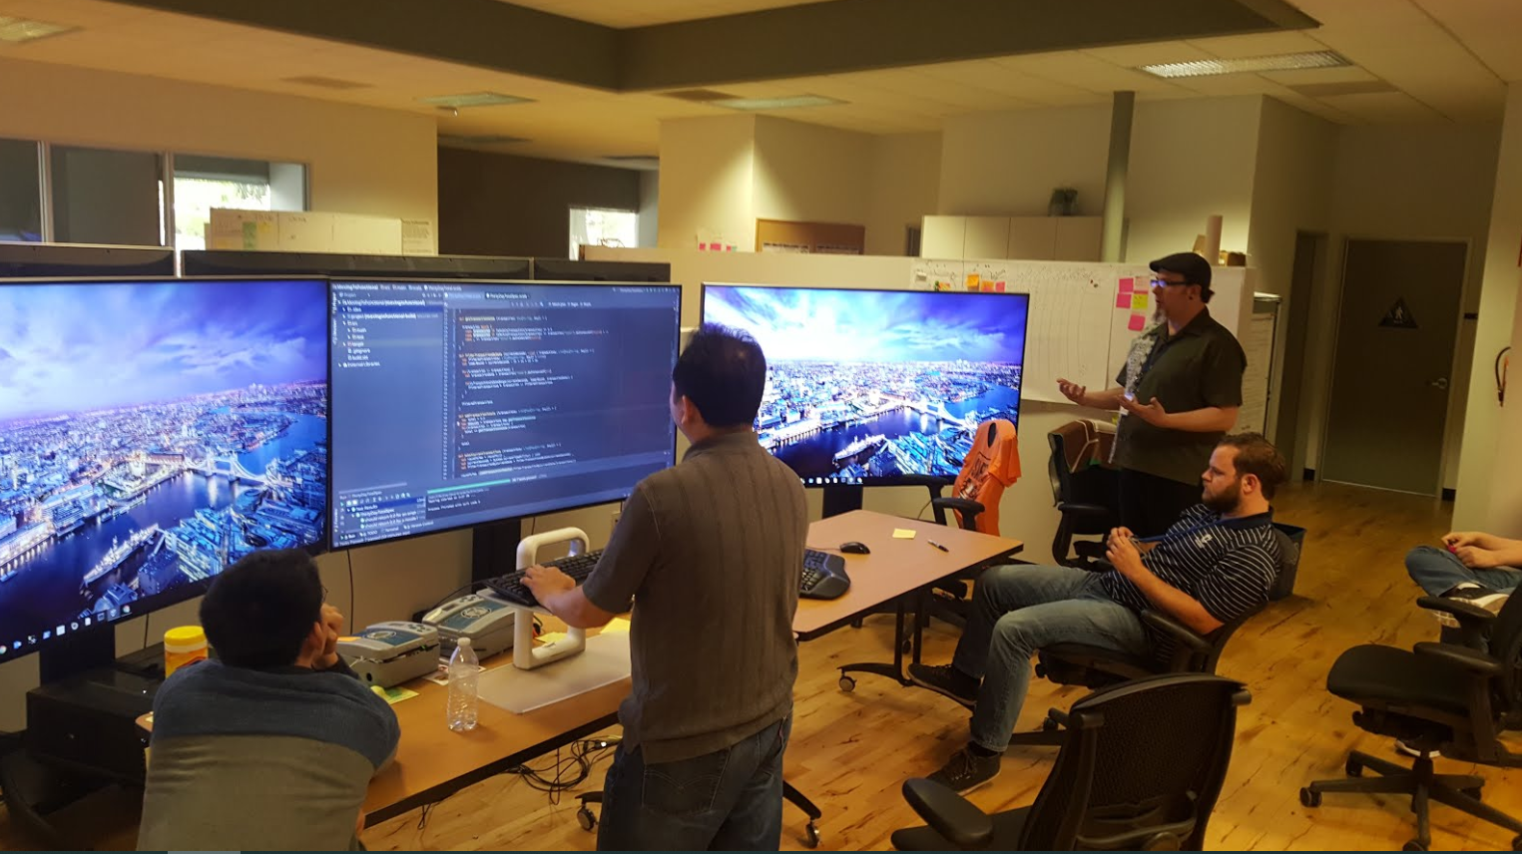
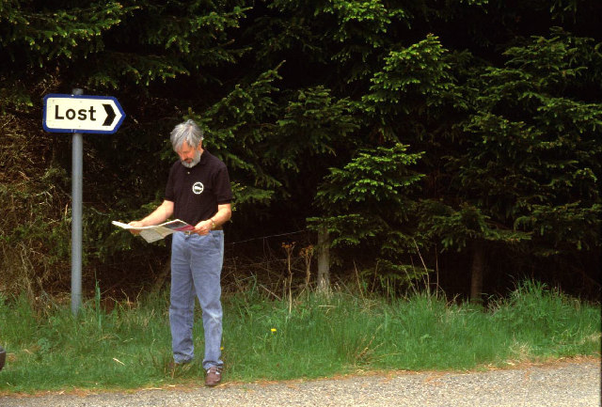
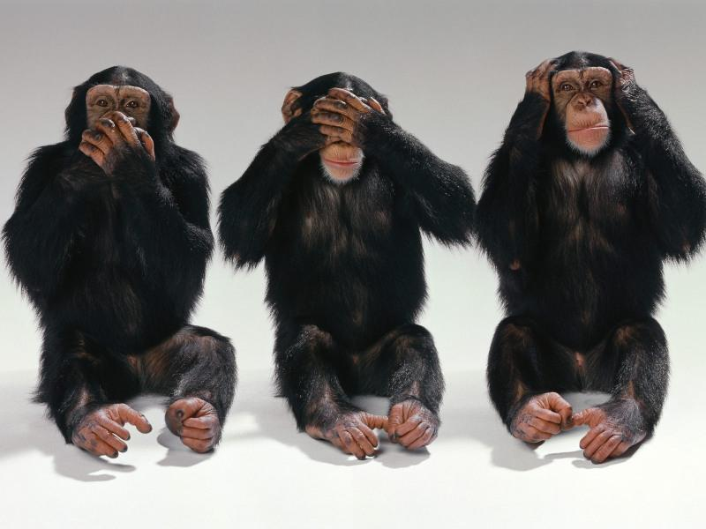
Ensemble (Mob) Programming
Typist
Rotate Roles: Every
5 min
Navigator
Advisors
Source: https://www.chrislucian.com/2016/05/mob-programming-q.html
“For an idea to go from someone’s head into the computer it must go through someone else’s hands.”
- Llewellyn Falco

Slide 6
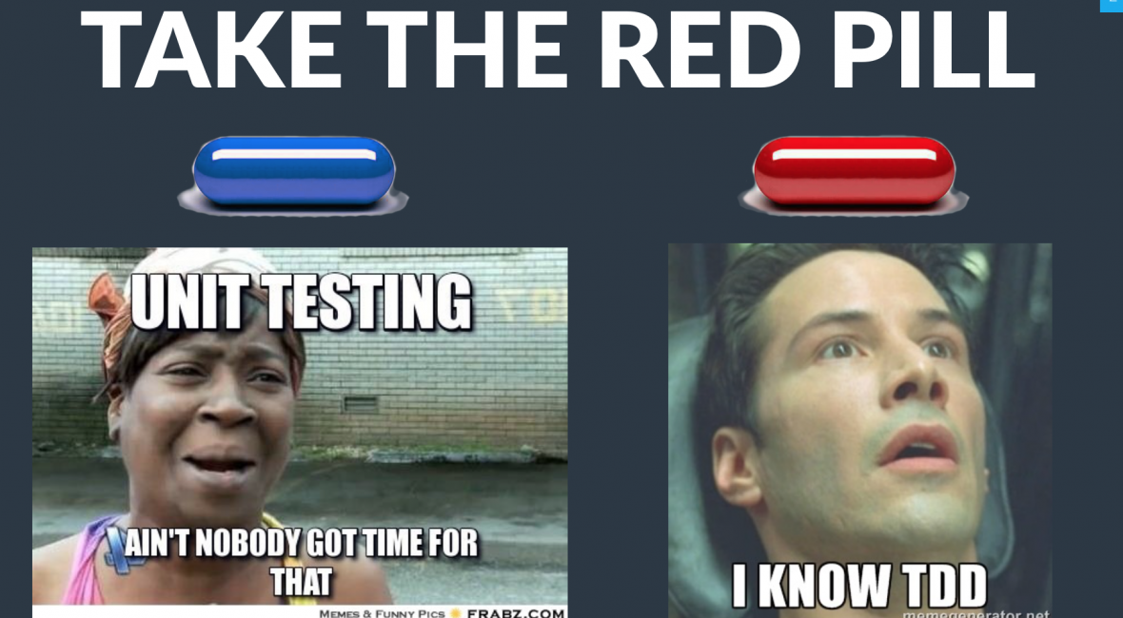
Test-Driven Development
Go fast always!
Why is it useful?
Change is Cheap!
Code is Clean!
Refactoring isn’t Scary!
Tests will save me!
Tests are up-to-date & fast!

Slide 7





TDD
How It Works
Write a failing test
Make it pass
Check-in to version control
Refactor
Check-in to version control
Failing Test
Passing Test
TDD Loop
Check-in to version control
Check-in to version control
Refactor

Slide 8
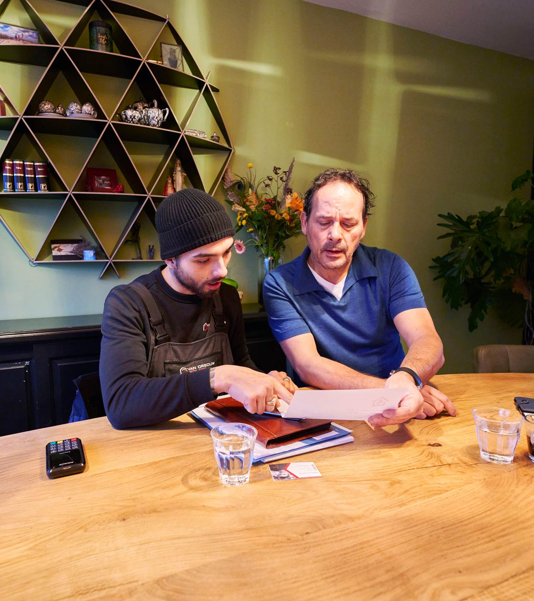
TDD Rules
You are not allowed to write any production code unless it is to make a failing unit test pass.
You are not allowed to write any more of a unit test than is sufficient to fail.
You are not allowed to write any more production code than is sufficient to pass the one failing unit test

Slide 9

Rules of the Road
Code without tests simply doesn't exist!
You can't discuss a technique without code
You can't show code without tests
Mastery
If it seems hard, find someone who can explain it
If it seems easy, explain to those who find it hard
No-one has mastery in all areas: everyone will both teach & learn
Have fun!

